Slide 1


Telling your financial story: Showing the world what your idea is worth…
David Hasler Chad Eames Bootcamp 1.0
(presented by Tom Vines)

Slide 2
Agenda:
Time = 1:15 (Dave/Tom)
Simplifying accounting & accounting statements
Identifying your business metrics
  Washing Machine
  Industry examples
Developing financial projections using your metrics
  Developing scenarios
Valuations and scenarios
Time = 0:45 (Chad)
How your financials will evolve as a startup
Notes:
I’m not a professional speaker, entertainer or comedian
This 1:15 will be much more interesting and valuable if we have group participation
My experience has been exclusively in large, multi-national organizations
So please forgive me if I make statements or use examples to which you struggle to relate
All of the concepts we’ll discuss apply to organizations of all sizes
In a group this large no 2 people are going to be in the same place
With respect to the maturity of their business idea and model
With respect to their experience with financial matters or general financial acumen
Therefore, some of what I say you may already know; some may be completely new to you or even confusing
So, let’s use our collective knowledge and experience to help everyone be better prepared to run a successful business

Slide 3
Accounting:
Humble beginnings with a serious purpose
Interesting History
  Ancient Mesopotamia, Egyptians and Babylonians (“auditor”)
  Roman army took this to the next level
  1494 Luca Pacioli, Venice, double-entry method publication (debits & credits)
  ~1600’s development of “joint-stock companies” required reporting
  1800’s formalized as a profession in Scotland/Britain
What are all those terms I’ve heard like CPA, U.S. GAAP, PCAOB, FASB, SEC etc.?
Dave’s definition
  “Keeping Score” in a way that everyone gets measured on a level playing field.

Slide 4
Accounting: Cash vs. Accrual Method
Cash Method (most of you will be here for a while)
  Recognizes revenues when cash is received, and expenses when paid
  Ignores/omits accounts receivable or accounts payable
  Simple to maintain…pull out the checkbook
  Not taxed until cash is received
Accrual Method (typical for virtually all larger businesses)
  Recognizes revenues (and related costs) when revenue is “earned”; expenses when they are “incurred” (Matching Principle)
  Provides better long-term view of business performance
  Required if you’re holding inventory
  Requires the addition of a Cash Flow Statement

Slide 5


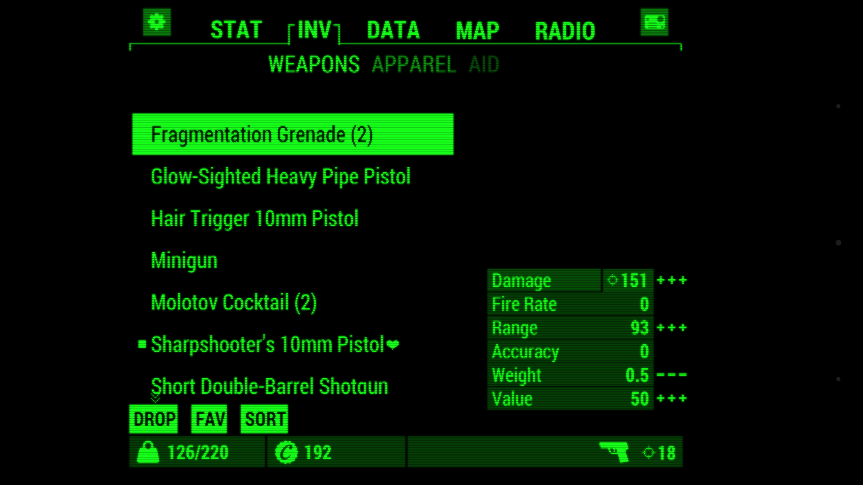
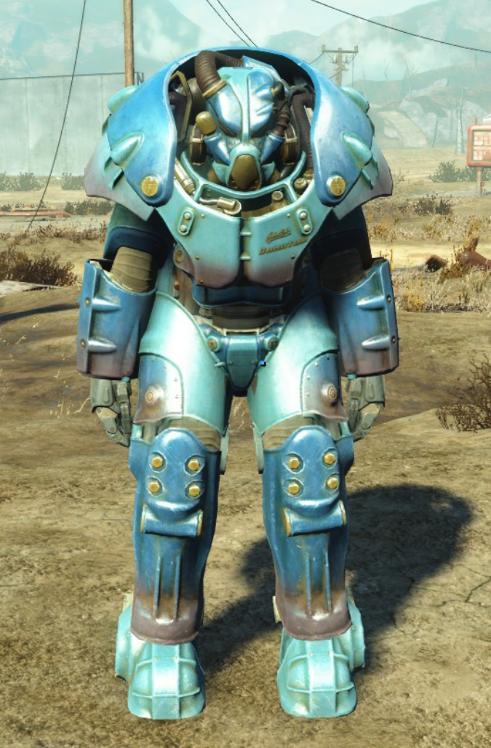

Financial Statements: “The Big Three”
Income Statement
  “What you did”
  Period of time measures
Balance Sheet
  “What you have”
  Point in time measures
Cash Flow
  “How’d you pay for all that?”
  Period of time measures

Slide 6

Financial Statements: Income Statement
“Report Card” of what you did over a period of time
  Sales/Revenue [$’s and % growth] – should always be net of discounts
    Cost of Goods Sold (COGS) [$’s and %]
  Gross Margin (= Sales – COGS) [$’s and %]
    Selling, General & Administrative Expenses (SG&A) [$’s and %]
  EBIT - Earning Before Interest & Taxes [$’s and %]
    Interest Expense
  “BT” Profit Before Taxes (Net Income) [$’s and %]
    Tax Expense
  Net Income After Tax [$’s and %]
  Depreciation and Amortization Expense can be mingled in COGS and SG&A
  “EBITDA” [$’s and %] EBIT with Depreciation & Amortization added back…”proxy for operating cash flow”

Slide 7

Financial Statements: Balance Sheet
It’s a “Snapshot” of what you have (or don’t have)
Assets (future benefit)
  “Current”…cash, accounts receivable, inventory…
  “Long Term”…buildings, equipment…
Liabilities (future obligation)
  “Current”…accounts payable, debt <1yr, taxes owed
  “Long Term”…loans…
Owner's (Stockholders') Equity
Assets = Liabilities + Shareholder Equity
  Usually solve for SE

Slide 8

Financial Statements: Cash Flow
Your “checkbook” over the same time period you’re measuring your Income Statement.
High level – start with net income and make adjustments
Cash inflows (sources of cash)
  Where did the positive inflows of cash come from?
Cash outflows (uses of cash)
  What did you spend the money on?
Positive or Negative Net Cash Flow
Starts with Net Income and tracked in three buckets:
  Cash flow from Operating Activities
  Cash flow from Investing Activities
  Cash flow from Financing Activities

Slide 9
Linkages between the statements and the importance of cash
Linkages between financial statements and company actions
  A decision to extend credit to a customer during a sale impacts:
    Revenue (Income Statement) and Accounts Receivable (Balance Sheet)
    The item sold moves out of Inventory (Balance Sheet) and into COGS (Income Statement)
    When the customer pays a credit bill, Accounts Receivable (Balance Sheet) is decreased and Cash (Cash Flow Statement) increases
  Cash on the Balance Sheet will equal end of year Cash balance on the Cash Flow Statement

Slide 10
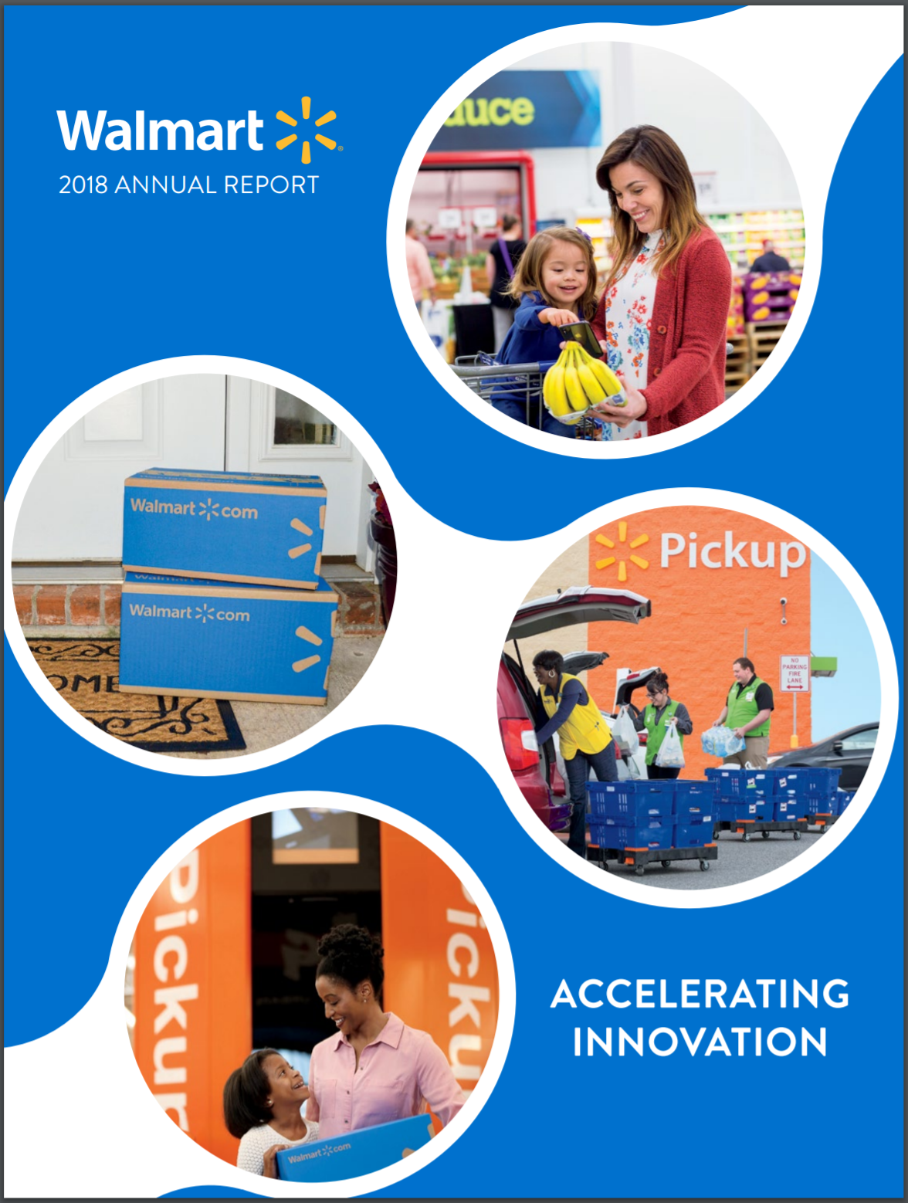
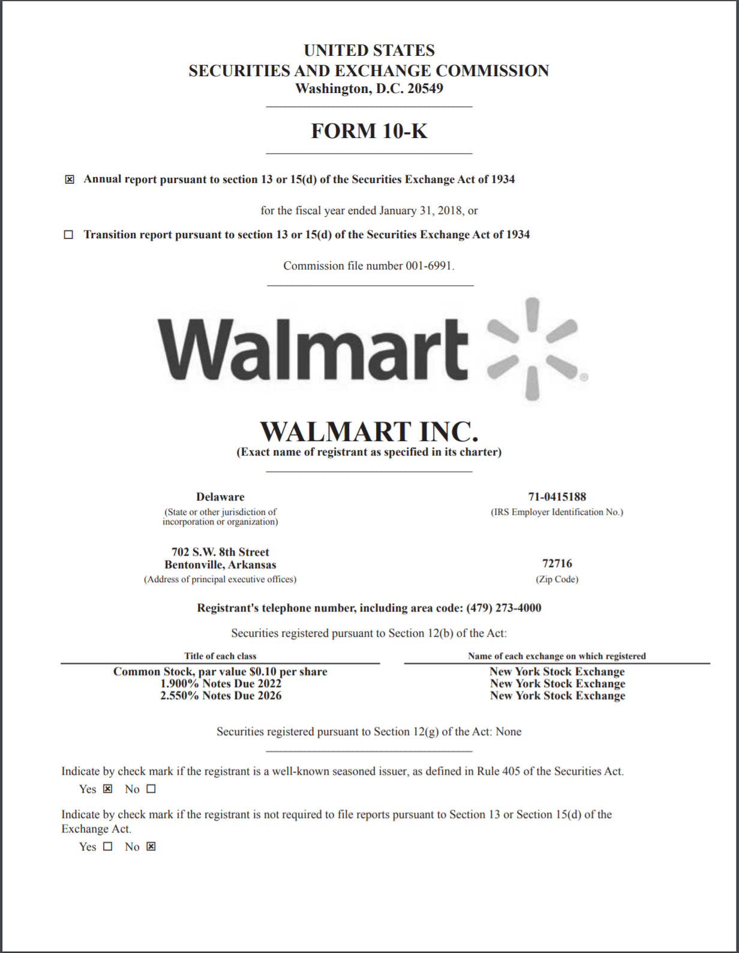
Homework
Review WMT’s 2018 statements (sec.gov…select Filings)

Slide 11
Financial Projections
The metrics that drive your business and tell your financial story
Notes:
What is a metric? Some definitions will use KPI’s, or Key Performance Indicators, to describe what we’re referring to in this presentation. A metric/KPI is a quantifiable measures that are indicative of, or critical to, the success of the business. They are leading indicators of revenue, costs or cash. They are likely NOT captured by traditional accounting systems.

Slide 12
Finance vs. Accounting
Both are valuable skill sets and jointly needed to create a successful company over the long term.
Accounting is about “keeping score” – and doing it ethically
But you also need to focus on the finance side of your business
Finance is about “changing the score” of even “changing the game”
  Analyzing, interpreting, forecasting…telling a story with numbers
  Strategy, tactics…planning, redirecting and pivoting
You’ll need some metrics & scenario modeling to do that…
Notes:
Accounting is: backwards focused, measuring historical financial performance; governed by a broadly accepted set of rules; largely applicable across multiple companies and industries
Finance is more forward-looking; not governed by a fixed set of rules (although you must be cognizant of the key accounting rules to assure you plan using the same rules by which you will keep score); useful for changing the companies direction and making decisions

Slide 13
Why Financial Planning and Metrics matter…
28% of small businesses that fail cite financial structure and/or knowledge of key business metrics as reason for failure.⁽¹⁾
1) “Building Your Small Business Accounting Team”, Zahorsky, March 8, 2018

Slide 14
Building relevant skills: Financial Modeling & Forecasting
What is often said:
“I made a P&(L) for three years and grew my sales by 3% and my overhead by 2%, then I created a Balance Sheet and Cash Flow statements to go along with that projection.”
What it should be is:
A metric driven “what if” analysis that provides insights into your business in addition to demonstrating future value/opportunity.
Resulting in a model that supports your projections but also explains why your projection was wrong…because it will always be wrong…and how to correct it.

Slide 15
Why metrics matter?
1
2
3
Your story
Create Business Metrics
Financial Projection
5
4
Revisit your Business Metrics
Your miss your forecast (+ or -)
6
6
7
Adjust your story based on what you learned from your metrics
Create business strategies to meet metrics
Your miss your forecast (+ or -)
and/or
“Rinse and repeat”
Notes:
Building you financial plan on metrics allows you to:
Have faith the projections can be achieved
Describe and defend your projections to knowledgeable users (e.g. investors, employees)
Monitor performance and progress
Assign owners to actionable activities and assess achievement
Compare actual results to plans and identify reasons for variance and possible actions to improve
Refine future projections to improve credibility and accuracy

Slide 16
The mechanics of developing a financial projection
Research
Build Assumptions (Metrics)
Forecast Topline
Build Supporting Financial Statements
Sensitivity & Reasonableness Testing
Adapted from: Entrepreneurship: The Practice And Mindset
Notes:
The Topline is king…everything else in you business is governed by the topline (e.g. investing, hiring, marketing, servicing debt or other financing)

Slide 17
Research: Defining the market and market growth
Defining (primary and secondary research)
  Primary research (boots on the ground, interviews…)
  Secondary research (reading, navigating the web…)
  Pitfalls of primary research…why secondary is important
Selling pathway = Consumer or business or both? (B2C? B2B?)
Importance of segmenting
  What portion of the market can you serve?
  How are segments growing/declining?
  How are habits and practices changing?
Using “proxy markets” where data is scarce
  Tire market example: What if data on tires weren’t available…how would you estimate?
Adapted from: Entrepreneurship: The Practice And Mindset

Slide 18
Research: Know your industry
How is profit made today?
  Grocery example
What are the “logistics” or constraints of my industry?
  Can someone in this process hold my idea hostage?
  Can the current infrastructure handle my idea?
What’s the industry lifecycle?
  Do I need to prepare for planned obsolescence?
Are there seasonal or cyclical patterns I need to worry about?
What happens after the sale? What do customers expect?
If others have tried and failed, what tripped them up?
Can I tease out the relevant metrics that matter?

Slide 19
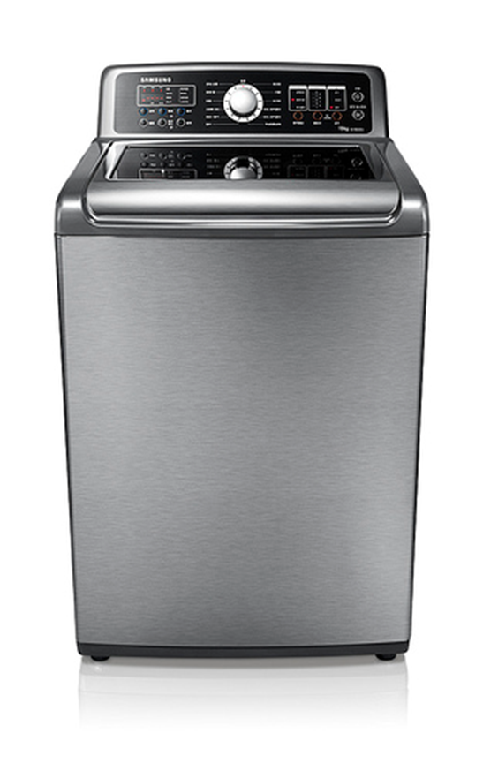
We have an advanced washing machine
You’ve just developed an advanced washing machine that can take any mix of clothing at once and wash 1 lb clothes in 30 seconds.
Your technology is so advanced that you’ve been able to prove that the clothes practically never wear out after being washed 100’s of times.
However, the tech and the soap are currently too expensive for in-home or on-premise use.
** We’ve figured out how to build it, but our only solution to monetize this tech is to reinvigorate the laundromat market and convince households and hotels to bring their clothes to you.
  We’ve done some consumer research and found that this would appeal to parents with kids if the service was same day and located on a frequented route.
  Businesses (like hotels) have told us they’d be willing to send their employees in the mornings and evenings to pick-up and drop-off large loads.
Notes:
Should the next two slides be handouts sent out before the class? Can PDF slides and send them out in advance if this is too dense.

Slide 20
Step One: Identifying drivers
What else do we know about our machine?
  It can hold 50lbs of clothes in a single wash
  It requires no softener, just the detergent we developed
  It can handle 1,000 loads before it needs preventive maintenance
What details did the parents give us?
  They liked that they didn’t have to separate clothes before they gave them to us.
  They liked that this could become a “1hr photo” like option
  Similar to milk or diapers, they are very aware of what they spend on laundry detergent and how many loads that will last.
What details did the businesses give us?
  They just want to pick up their bulk loads early in the morning and drop them off in the later afternoon.
  They track how much they spend on pounds of laundry and push consumers to make the “green choice”
  Laundry is one of their biggest expenses, behind only labor and lease expenses
Q: What kind of metrics can we glean from this list?
Notes:
Student participation: 5 minutes
Go to the board and write down student responses

Slide 21
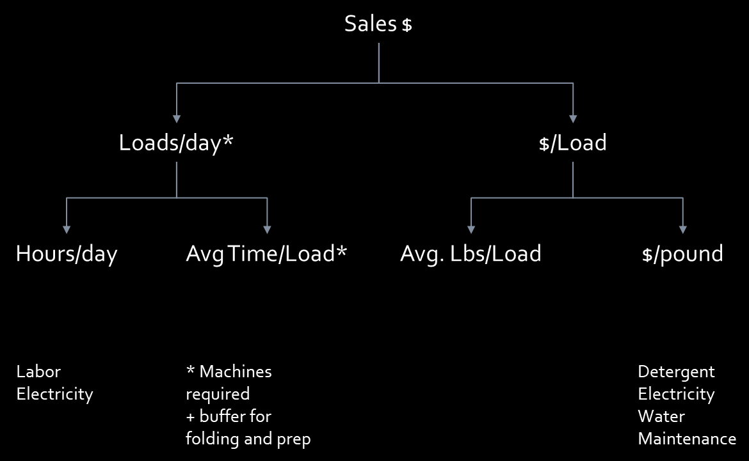
Build Assumptions:Our new washing machine drivers
Sales $
Loads/Cust.
Customers
Price/Load
Loads/day*
Hours/day
Avg Time/Load*
Avg. Lbs/Load
Price/pound
Labor
Electricity
* Machines required
+ buffer for folding and prep
Detergent
Electricity
Water
Maintenance
Margin/Load
B2C
+
B2B
=
Total
Notes:
How Hasler would set up the metrics for our washing machine business
What metric are the moms focused on? How will we market to them?
What metric we the hotels focused on? How will me market to them?
Did you notice what we were able to do there? Our metrics not only helped us forecast the business…but it also just informed our marketing plan…

Slide 22
Pitfalls and traps when identifying drivers
Oversimplifying the drivers.
  Forecasting with drivers is naturally complex.
Not connecting the driver to external realities or customer behaviors
  Massmart and large format stores
  WMT and $1 potato chips
Missing the inter-connectivity of the drivers
  How do those drivers relate to each other?
  Do I have a stand-alone driver and why do I need it?
  Example: retail experiences
Assuming you already know the drivers, not testing your assumptions
Notes:
MassMart – African market; applied US rule: cities over 1M people could support large format stores; executed acquisition on this basis
Clearly didn’t identify the correct metric: Perhaps purchasing power of GDP measure would have been better than population
$1 potato chips: Walmart was experiencing decreased customer traffic; implemented a $1 potato chips (and other) promotion to increase traffic. Instead, people just pantry loaded and actually made fewer trips to the store

Slide 23









Retail analytics
(examples)
Sales Growth
+
Non-Comp
Comparable
+
Store Changes
Transactions
Basket Size
Gas Prices
+
Size
$/SQFT
Locations
“story”
UPT
(units/trans)
AUR
(avg. unit retail)
Honorable mentions: Sales/Labor Hour (SPLH), Gross Profit/SQFT, Direct Labor as a % of Sales, etc.
Note: Growth in some of these numbers can be a “bad” thing.

Slide 24








Airline analytics
(examples)
Revenue
RASM
(Rev/ASM)
Rev/RGP
BELF
(CASM/Yield)
LF%
(Load Factor)
Yield
(RGP * REV/RGP)/RPM
CASM
(Cost/ASM)
ASM
(Avail. Seat Miles)
RPM
(Rev. Pass. Miles)
BF %
(Booking Factor)
Honorable Mentions: spread between BELF and LF, Cost/Flight Hour, Staff Cost/RGP
Cost/Expenses
Miles
AS
(Avail. Seats)
RGP
(Rev. Gen. Pass)
#1 Crude Oil Prices
#3 Disp. Income
#2 Staffing Costs

Slide 25
Step Two: Create scenarios for those drivers
The ultimate goal of a good forecast is *not* to land on a single number.
  Rule #1 - Your forecast will always be wrong
It is to:
  Present the “tightest” story possible on the most probable outcome
  while making sure the “customer” of the data is fully aware of the potential downside and upside that exists
At a minimum I would always have a “worse case”, “most likely” and “best case” set of scenarios.
  Applying those to several drivers helps you create “stories” regarding assumptions (and their inter-connectivity)
  It also provides a “healthy” platform for stakeholders to give feedback
  Example: No Time 2 Cook

Slide 26
Build Assumptions: Remember our washing machine drivers?
Sales $
Loads/Cust.
Customers
Price/Load
Cust. per Day
Loads/day*
Hours/day
Avg Time/Load*
Avg. Lbs/Load
Price/pound
Loads per Machine
Labor
Electricity
* Machines required
+ buffer for folding and prep
Detergent
Electricity
Water
Maintenance
Margin/Load
B2C
+
B2B
=
To. Co.

Slide 27
Scenario Example
What if…
Household (B2C) scenarios
  Best Case: 4 loads per week, $1.00/load,2lbs/load
  Most Likely: 3 loads per week, $1.50/load, 3lbs/load
  Worse Case: 2 loads per week, $1.75/load, 5lbs/load
Hotel (B2B) Scenarios
  Best Case: 500lbs/day, $0.30/lb, +10min labor
  Most Likely: 350lbs/day, $0.35/lb, +15min labor
  Worse Case: 200lbs/day, $0.40/lb, +20min labor

Slide 28
Forecast Topline: Sensitivity Testing
Worse Case, Most Likely, Best Case
Mach. / Loc.
Loads / Cust.
Cust. / Day
8
10
12
1.5
1.75
2.0
250
350
450

Slide 29
Forecast Topline: Map out the results, eliminate outliers
“Loyal Customer” Scenario
250 Customers/day, 2.0 loads/customer, 12 machines per location, customer expects availability
350 Customers/day, 1.8 loads/customer, 10 machines per location, customer expects some wait time
“Balanced Customer” Scenario
“High Traffic” Scenario
450 Customers/day, 1.5 loads/customer, 8 machines per location, customer expects end of day availability
What would these scenarios tell us about pricing, staffing, etc.?

Slide 30
Step Three: Get buy-in from your stakeholders on the drivers and scenarios *not* the answer
Forecasting with drivers allows you to connect operations to the forecast and truly hold them accountable.
  It’s hard to “run” when your department head or field operator has signed up to a target involving a driver (activity)
A good driver/scenario based forecast requires a two-stage review process…and sometimes a third.
  This is why most people don’t do it. They’d prefer the high conflict method of just throwing out a profit number in a review meeting
Getting buy-in from your stakeholders also makes it “their” forecast and not “your” forecast.
  You might also call it “our” forecast

Slide 31
Step Four: Track the drivers and report with the forecast
Reporting on non-financial measures will require some extra work.
  I would argue that a segregation of duties should exist and they should be independently tracked.
Because the drivers are the basis of your forecast, they become the “canary in the coal mine” for your business or project.
  Insightful drivers are often good predictors of future performance, but may not immediately manifest themselves in the financial results.
  Why?
As soon as the drivers are “out of bounds” you should rally the troops even if it hasn’t materialized in the forecast.
  Be an advocate along with your finance partner and promote the dialogue.
  Insist on specific action plans timeline to address outliers
“Closing the books at the end of the month should just be a manifestation of what you already know about your business.”

Slide 32
Forecast Topline: Using our metrics
First Location
Two Locations
Three Locations
What can I do with this basic model?...next steps?

Slide 33
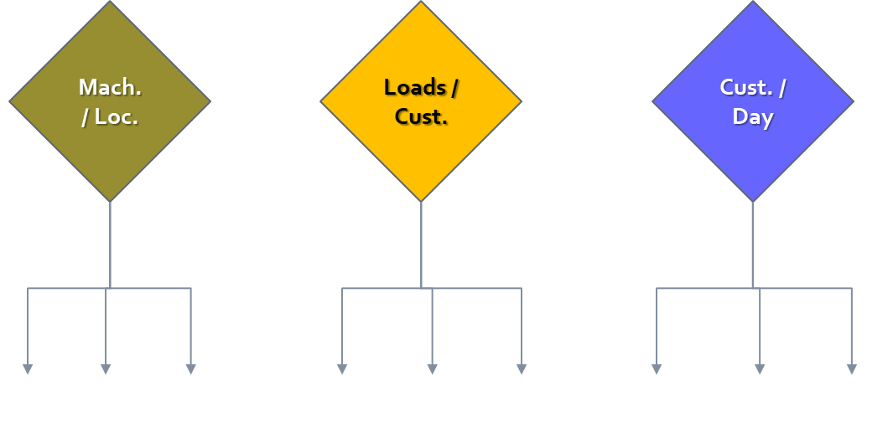
Building the detail for your Financial Statements
Scenarios?
Scenarios?
Scenarios?
Pricing
Mat. Cost
Labor Matrix
Mtkg. Rates
H.O. Staff
Revenue Forecast
COGS Forecast
SG&A Forecast

Slide 34
Washing Machine tracker
What are two problems you can identify from this tracker?
What would be some things we can do to change those metrics?

Slide 35
Valuations using our scenarios
Industry research indicates deal multiples of 1.5x sales and/or 3.5x on EBITDA…
Loyal Customer
Cust./Day = 250
Loads/Cust. = 2.0
Balanced Customer
Cust./Day = 350
High Traffic
Cust./Day = 450
Mach./Loc. = 12
Loads/Cust. = 1.8
Mach./Loc. = 10
Loads/Cust. = 1.5
Mach./Loc. = 8
Low sales, high margin
Moderate sales, average margin
High sales, moderate margin
Yr5 Sales = $20M
Yr5 EBITDA = $12M
$30M sales valuation, $42M EBITDA valuation
Yr5 EBITDA = $10M
$38M sales valuation, $35M EBITDA valuation
Yr5 Sales = $25M
Yr5 EBITDA = $8M
$45M sales valuation, $28M EBITDA valuation
Yr5 Sales = $30M

Slide 36
Here’s what to expect
Chad Eames
The evolving nature of your financial projections…

